Slide 1
IBM Capstone

Slide 2
Introduction/Business Problem
Large cities often have many restaurants due to the density of people. We are looking at the feasibility of starting a new restaurant. We will look at a metropolitan area, and analyze the neighborhoods to determine if a new restaurant will have sufficient clientele. To determine clientele, we will analyze specific areas and determine cuisine preference over an area. We will determine which restaurant to start based on scarcity of specific cuisines in different areas of our city. Our target meal will be lunch, so we will have to analyze businesses in the area as well. The target audience will be the employees at nearby businesses, who will want a diverse option of lunches.

Slide 3
Data
Data needed will be businesses and their coordinates, and restaurant types and their coordinates. Data will be analyzed to determine which new restaurants should be placed in an area based on scarcity of cuisine in that area. I will use a geocoder to find locations. The Foursquare API will be used extensively.

Slide 4
Methodology
In order to obtain the data needed, segmenting and clustering was used. Wikipedia was used as a data source, from where data was scraped. The Pandas data frame was utilized.

Slide 5
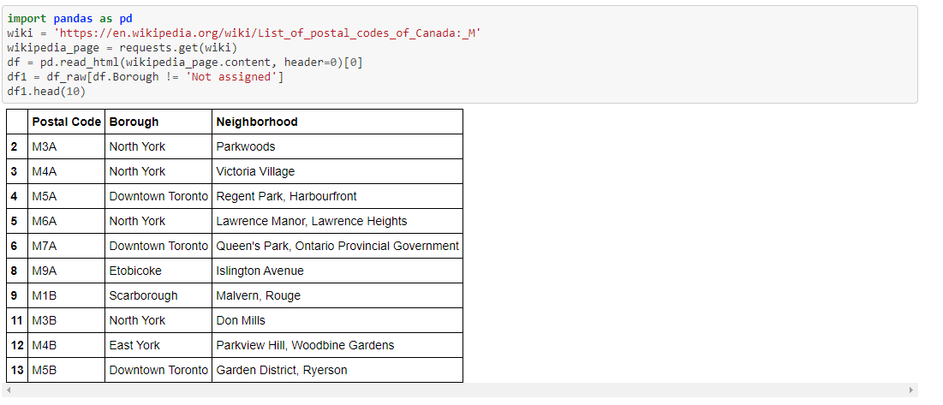
Results
Table 1

Slide 6
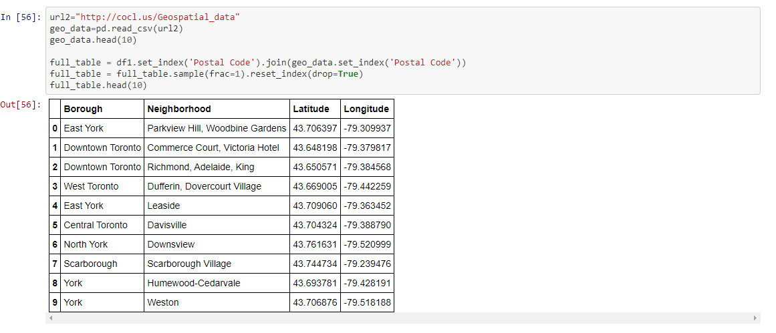
Table 2

Slide 7
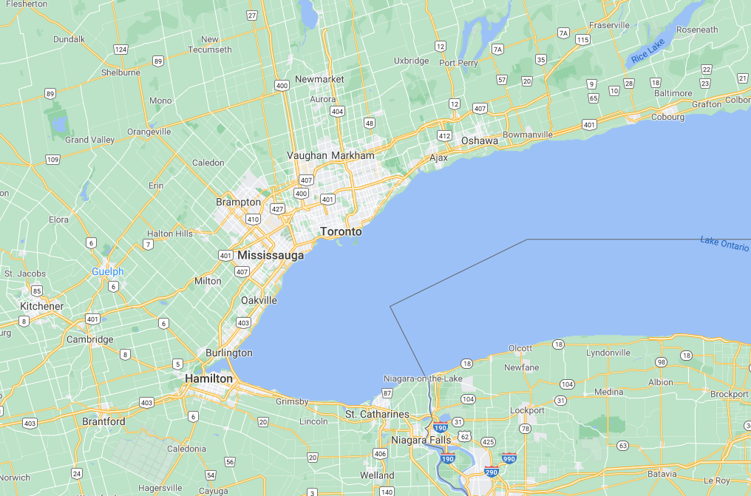
Images
Figure 1

Slide 8
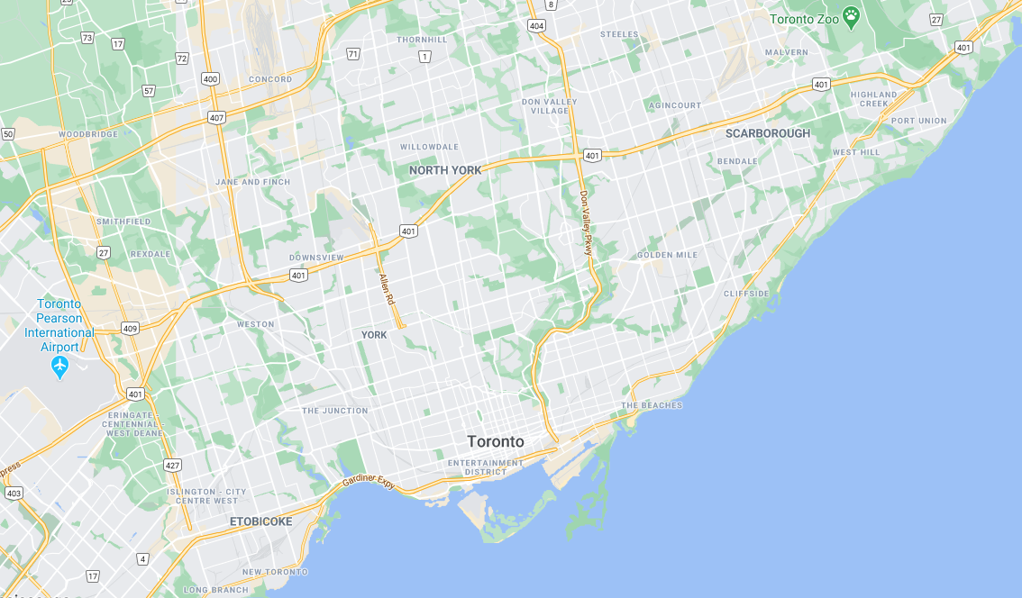
Figure 2

Slide 9
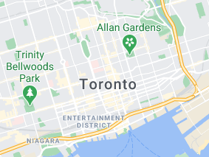
Figure 3

Slide 10
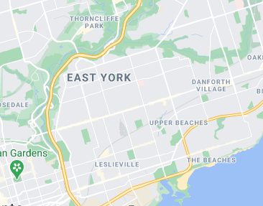
Figure 4

Slide 11
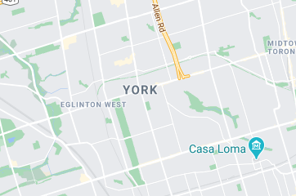
Figure 5

Slide 12
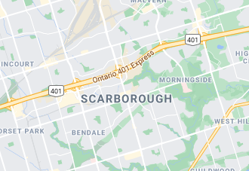
Figure 6

Slide 13
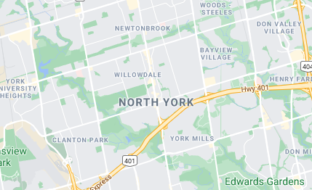
Figure 7

Slide 14
Discussion and Conclusion:
To keep it simple, my data frame is organized by neighborhood seen above. This gives geographical, neighborhood, and location information (See Table 1-2; figure 1-7).

